Slide 1
Building on the Past…Focused on the Future
CEO Panel

Slide 2




Charles McCrary
President & CEO
Paul Bowers
President & CEO
Mark Crosswhite
President & CEO
Ed Day
President & CEO

Slide 3
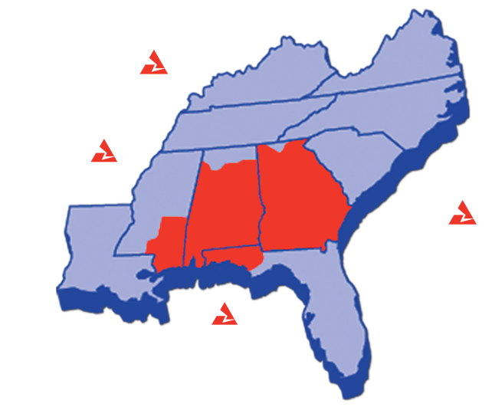
Premier Utility Franchises
95% of 2011 Earnings Forecast
Strong operational performance
Proven and constructive regulatory frameworks
Diverse economy and customer mix

Slide 4
A customer-focused business model…
Healthy
Capital Spending
Constructive
Regulation
CUSTOMERS
High Reliability
Low Prices
High Customer Satisfaction

Slide 5
…that continues to deliver top quartile ROE
14%
12%
Targeting
12.4% to 13.0%
for 2011-2013
10%
8%
Weighted Average Return on Equity
(4 Traditional OpCo’s)
6%
4%
2%
0%
2001A
2002A
2003A
2004A
2005A
2006A
2007A
2008A
2009A
2010A
2011
2012
2013

Slide 6
Mark Crosswhite, President & CEO

Slide 7
Gulf Power
Florida PSC Update
Regulatory Update
Economic Development
Economic Outlook For Northwest Florida

Slide 8
Florida Public Service Commission
Five members appointed by Governor
4 of 5 commissioners were appointed by Governor Crist within the last 12 months
All four were withdrawn and reappointed by Governor Scott and are awaiting senate confirmation

Slide 9
Regulatory Framework
Retail Base Rates
10.75% - 12.75% authorized retail ROE
Rates set on 12% ROE
Four Retail Recovery Clauses
Fuel & Purchased Energy Costs
Purchased Power Capacity Costs
Environmental Costs
Energy Conservation Costs
2010 Retail Revenues
Capacity
Conservation
4%
1%
Environmental
Base
12%
35%
Fuel
48%

Slide 10
State Regulatory Environment
Recent Successes
Approval of Gulf’s Environmental Compliance Plan for CAIR, CAMR & CAVR
  Crist Scrubber (over $600M of investment)
Approval of 2011 Cost Recovery Clause Factors
Approval of updated depreciation rates and dismantlement costs
Approval of Central Alabama PPA
Approval of Gulf’s Demand Side Management Plan

Slide 11
’11-’13 Capital Expenditures = $1.2B - $1.3B
Gulf Power
$384M - $491M
$396M - $452M
Potential Compliance Investments up to $180M*
$381M - $398M
$0M - $107M
$0M - $56M
$0M - $17M
Base Capex (M$)
'11-'13
Base Environmental
$618
T&D Growth
109
Maintenance (G, T & D)
401
General
34
Gulf Power
$1,161
*Potential environmental controls, replacement generation capacity, and/or transmission upgrades. Compliance strategy will be determined based on the nature of any final rules, compliance timeframes and cost.

Slide 12
Credit Ratings – Gulf Power
Key Credit Strengths
Regulatory environment is generally constructive and supportive of credit quality
Fuel and environmental clauses promote timely recovery
Stable cash flows
Manageable capital expenditure program
Senior Unsecured Debt
Standard and Poor’s | A
Moody’s | A3
Fitch | A

Slide 13
Regional Economy
Slow-paced recovery
Predominately residential and commercial customer base
Unemployment and income growth expected to return to normal levels by 2012

Slide 14
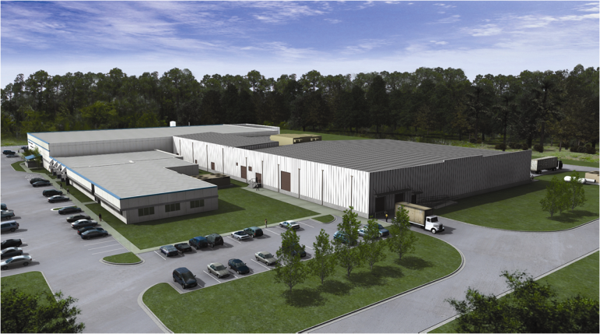
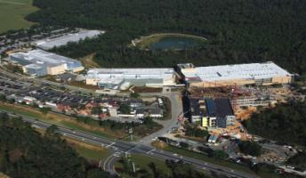
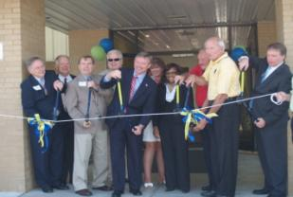
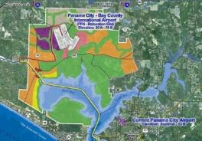
Economic Development
Pall Life Sciences
$37.5M Investment – 40,000 sf Manufacturing Expansion
Navy Federal Credit Union
224,000 sf Expansion – 800 New Jobs
West Bay Sector Plan
Bay County
Clearwire
Retention/Expansion – 500 jobs

Slide 15
Constructive
Regulation
Healthy
Capital Spending
CUSTOMERS
High Reliability
Low Prices
High Customer Satisfaction
Strong regulatory framework
Successfully navigating FL political and regulatory environments
Economic recovery is slow, but steady

Slide 16
2010 Successes
Safety
Rated 1st among SEE Utilities (total company performance)
Customer Value
Rated 1st among 22 peer utilities
Operations
Industry leader in reliability
Kemper Project
PSC certificate for construction
~$700 million in federal incentives
Earnings
Outperformed expectations with 11.5% ROE
*Source: SCS Marketing Research – 2010 Customer Value Benchmark Survey

Slide 17


