Slide 1
Strengthening Key Relationships… and Strengthening the Process
Katrina McMurrian, CCIF Executive Director
2016 National Conference of Regulatory Attorneys
Grand Hyatt Tampa Bay, Tampa, FL
June 21, 2016

Slide 2
CCIF Key Elements
3 core communities = state commissioners + consumer advocates + electric utility representatives
Energy topic
Candid dialogue and debate
Collaboration and consensus-building
Report to memorialize group’s work

Slide 3
CCIF Leadership
CCIF Executive Committee:
Travis Kavulla
NARUC President &
MT PSC Vice Chairman
Bob Nelson
NASUCA President &
MT Consumer Counsel
David K. Owens
EEI Executive VP of Business Operations & Regulatory Affairs
CCIF Advisory Committee:
David Danner, WA UTC
Libby Jacobs, IA UB
Ellen Nowak, PSC of WI
Simon ffitch, WA AGO
Elin Katz, CT OCC
J.R. Kelly, FL OPC
Greg Bollom, Madison G&E
Wayne Harbaugh, BG&E
Phillip R. May, Entergy LA

Slide 4
CCIF Signature Process
Large, open kickoff event to introduce a topic and initiate discussion among 3 groups;
Series of smaller, invitation-only summits where the 3 groups engage in facilitated dialogue; and
Report to share key takeaways with the broad stakeholder community and to serve as a foundation for outreach and additional dialogue.

Slide 5
CCIF Kickoff

Slide 6
CCIF Summits

Slide 7
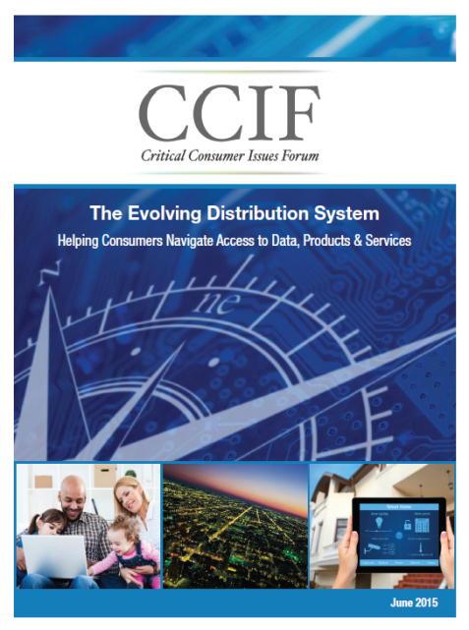
CCIF Reports
Grid Modernization, July 2011
Regulatory Process, July 2012
Distributed Energy Resources, July 2013
Distributed Generation, July 2014
Evolving Distribution System, July 2015
Consumer Solutions, July 2016

Slide 8
Value of CCIF Reports
Demonstrate leadership of 3 core groups
Demonstrate shared support for key concepts to broader stakeholder community
Focus on consumer aspects of key energy topics and often facilitate proactive consumer education & protection
Initiate, inform or focus dialogue at the state level (regulatory and broader public policy dialogue)
Serve as a foundation for outreach and additional dialogue

Slide 9
CCIF Next Steps
Release of CCIF 2016 Report: Consumer Solutions
During NARUC Summer Meetings in Nashville, TN
Outreach and follow-up on key issues
CCIF’s 7th Annual Kickoff Forum – Topic TBD
Collocated with NARUC & NASUCA Annual Meetings
Saturday, Nov. 12th, 2–5 pm, NARUC conference hotel, La Quinta, CA

Slide 10
CCIF Value
Brings together key people to advance dialogue on key issues
Provides non-adversarial, safe environment
Gives all 3 groups a voice in process
Develops consensus or at least an understanding and appreciation of varying perspectives
Encourages collaboration instead of confrontation
Strengthens key relationships . . . and the regulatory process

Slide 11
Benefits of Consumer Advocate Participation in CCIF
Adds valuable voice on behalf of consumer
Adds experience to dialogue and credibility to results
Provides opportunity to educate and become more educated on topic and on positions/rationale
Promotes collaboration and civility over confrontation
Establishes or strengthens relationships w/ other participants

Slide 12
For More Info on CCIF
Email: katrina@CCIForum.com
Phone: 615.905.1375
Website: www.CCIForum.com
Twitter: CCIForum

