Slide 1
Advancing Energy Justice
Ensuring Equitable Access to Clean Energy—Jacqui Patterson

Slide 2
Overview
Challenges of Fossil Fuel Based Energy Production—Who Pays the Price?
Economic Relationship of Low Income Communities and Communities of Color in the Current Energy Economy
Policy Constraints in the Emerging Energy Economies—Proposed Remedies
Integrating Economic Justice Mechanisms
Promising Models for Equitable Clean Energy Access

Slide 3
Challenges of Fossil Fuel Based Energy Production and the Current Price Paid by African American Communities

Slide 5
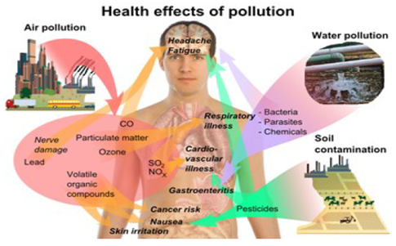
Effects of Pollution
Notes:
You can point out that this is a picture of a mother feeding her three headed bird, a grim reference to the birth defects that result from exposure to toxic waste.
After – say animals are not the only organisms affected, there are also human health effects of pollution

Slide 7
Climate Change

Slide 9
The Economics of Our Current Relationship With the Energy Sector

Slide 10
$6T
$41B
1.1%
<.1%

Slide 11
13x
59.2%

Slide 12
African American Communities and Energy
African Americans spend a significantly higher fraction of total expenditures on energy use than non-African Americans in America for almost all income levels.
African Americans comprise 12.7% of the overall population. Based on an eligibility model and self-reporting, African Americans are estimated to receive an estimated 23-25% of LIHEAP funds.

Slide 13
2008 Snapshot of Energy Poverty
By April, Pennsylvania Power and Light Electric Utilities disconnected 7,054 customers---up 168%.
Duke Energy in North Carolina averaged about 11,000 shutoffs a month--10% of its 1.4 million residential customers.
For Peoples Gas in Chicago, disconnects were up 27%.
Disconnects were14% for Southern California Edison
Shutoffs were at 56% for Detroit Edison--In Michigan, where home foreclosures were soaring and the unemployment rate is the USA's highest, more than one in five Detroit Edison customers were behind in their electric bills by May.

Slide 14
Electricity Affordability Index

Slide 15
Towards Energy Democracy—Equity Based Solutions
Countering Grid Destabilization and Rate Hikes Through Energy Sovereignty

Slide 16
Goal
Ensure that vulnerable communities/households can access sufficient and affordable electricity as we traverse the clean energy transition.

Slide 17
Let’s Not Put the New Wine of Clean Energy
in the Old Wine Skins of an
Antiquated Utility Business Model

Slide 18
Today’s Clean Energy Policies
Mostly support:
Individual homeowners though tax credits, which excludes a third of all families and half of all families of color who don’t own their homes; OR
Large-scale projects like the $2.2 billion thermal solar plant in the Mojave Desert.

Slide 20
Lack of Access to Technical Assistance
BARRIER: Communities of color are neglected by most technical assistance programs
SOLUTION: Technical assistance programs must support community based endeavors in low-income communities and communities of color.

Slide 21
Production Tax Credit Shortcomings
Federal production tax credit used to finance residential renewables applies only to homeowners.
This shuts out:
25 percent of White Americans
50 percent of African American and Latino Americans who are renters and cannot benefit from the tax credit.

Slide 22
SOLUTION: Expand Beyond Limits to Homeowners
BARRIER: Focusing on homeowners excludes most people of color
SOLUTION: Expand production tax credits (PTC) to support community scale projects

Slide 23
Net Metering Limits
BARRIER: Most net metering rules have cap limits and fail to allow community aggregation.
SOLUTION: States should support cap-free and net aggregation rules.

Slide 24
Limited Grid Access
BARRIER:
Communities of color, who are often small business holders, are not ensured access to the electrical grid which gives energy entrepreneurs the ability to sell the energy they produce.
SOLUTION:
The Federal Electric Regulatory Commission (FERC) can develop equitable access requirements for the grid for small scale produce.

Slide 25
Recommended Reading

Slide 26
Promising Model Solutions
On-Bill Financing
Aggregation/Collective Purchasing
Consumer Choice
Rural Electric Co-Ops
Cooperatives
Solar/Wind Gardens

Slide 27
Consumer Engagement in Policymaking
Rural Electric Co-Op Boards
Public Service Commission/Public Utilities Commission

Slide 28
Unlocking Clean Energy to Power and EMPOWER Our Communities
National Association for the Advancement of Colored People (NAACP)
Environmental and Climate Justice Program
February 2014

Slide 29
Pillars of Our Energy Democracy Agenda
Energy Efficiency Resource Standards
Renewable Portfolio Standards
Distributed Generation/Net Metering
Community Ownership and Asset Development
Economic Justice
Political Power Building

Slide 30
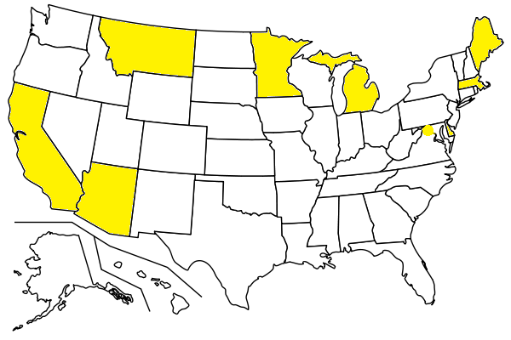
Local Hire Provisions
Local hiring
and energy modernization
February 2014

Slide 31
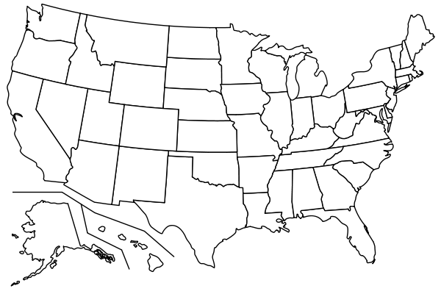
Minority and Women
Business Enterprise Provisions
All states have some
MBE presence; none explicitly target energy
February 2014

Slide 32
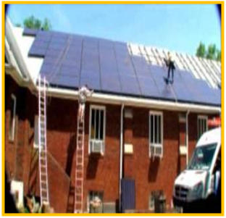
Community Asset Development
Too few community asset
development examples!!!
February 2014

Slide 33
Addressing Alternate Views

Slide 34
!!Well Financed, Shrewdly Messaged
War On Net Metering!!
…then click the placeholders to add your own pictures and captions.

Slide 37
On the Picture Tools | Format tab, you can create your own frames and make picture corrections such as adjusting contrast and brightness or cropping the picture for just the right look.

Slide 38
Advancing Opportunities for Low Income Affordable Access and
African American Leadership
in the New Energy Economy

Slide 39
Just Energy Policy Campaign Values
Wellbeing of Our Communities—Including Safety and Health
Economic Opportunity
True Democracy

Slide 40
Promising Practices

Slide 41
Low Income Access to Solar
On-Bill Financing
Aggregation/Collective Purchasing (ex. NAACP HQ)
Consumer Choice
Cooperatives/Solar Gardens

Slide 42
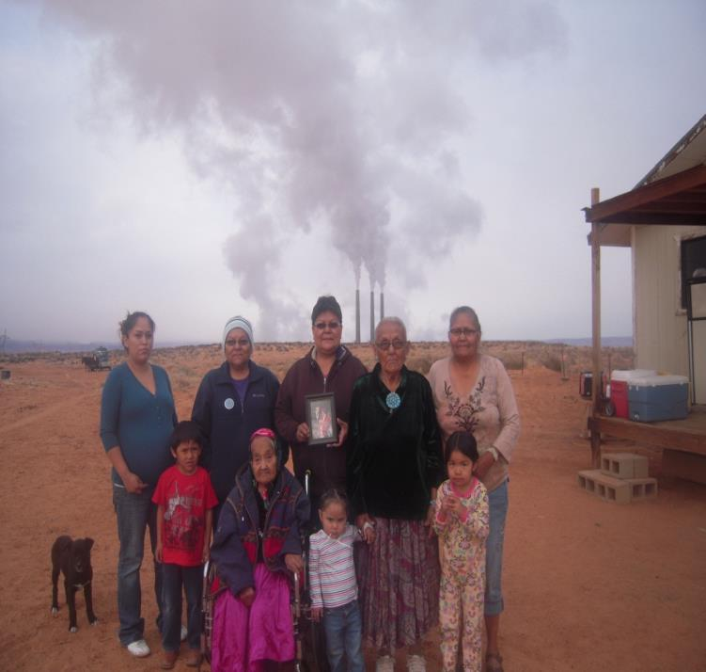
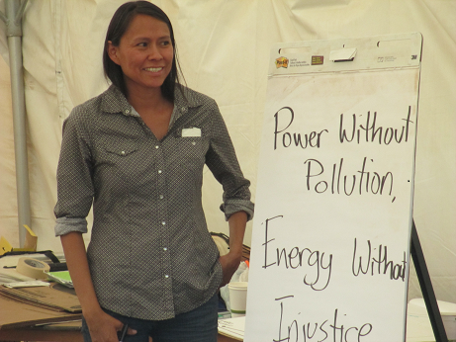

Slide 44
https://www.youtube.com/watch?v=vr8_kqeYfpU#t=71

Slide 47
Economic Opportunity

Slide 49
Unified Campaigning for Energy Democracy
Embracing SHARED Goals
INTERSECTIONAL MESSAGING
EQUITABLE ACCESS TO CLEAN ENERGY
ENTREPRENEURSHIP OPPORTUNITIES
TRAINING AND JOBS
TRUE DEMOCRACY

Slide 50
Thank You
Jacqui Patterson
jpatterson@naacpnet.org
@jacquipatt
443-465-9809

