Slide 1
The FERC Trio at the Supreme Court:
A Treasure Trove of Guidance −
What Are States to Do with the Booty?
Ari Peskoe
Senior Mate in Electricity Law
apeskoe@law.harvard.edu

Slide 2
Overview
The Federal Power Act and Natural Gas Act
OneOK v. Learjet (2015)
FERC v. EPSA (2016)
Hughes v. Talen Energy (2016)
The State-Federal Jurisdictional Border

Slide 3
Preemption
Federal action preempts State law when:
Congress has explicitly preempted State law;
A court determines Federal law occupies the field; or
A court determines that Federal law conflicts with State law.

Slide 4
The Federal Power Act
FERC’s jurisdiction includes:
the transmission of electric energy in interstate commerce
the sale of electric energy at wholesale in interstate commerce
“any rule, regulation, practice, or contract affecting [the] rate” of 1) or 2)
FERC’s jurisdiction does NOT cover:
“any other sale of electric energy”
facilities used for the generation of electric energy
facilities used in local distribution or only for the transmission of electric energy in intrastate commerce

Slide 5
The Natural Gas Act
FERC’s jurisdiction includes:
the transmission of electric energy in interstate commerce
the sale of electric energy at wholesale in interstate commerce
“any rule, regulation, practice, or contract affecting [the] rate” of 1) or 2)
FERC’s jurisdiction does NOT cover:
“any other sale of electric energy”
facilities used for the generation of electric energy
facilities used in local distribution or only for the transmission of electric energy in intrastate commerce
the transportation of natural gas in interstate commerce
the sale in interstate commerce of natural gas for resale
“any other transportation or sale of natural gas”
facilities used for such distribution or to the production or gathering of natural gas.

Slide 6
The Natural Gas Act
FERC’s jurisdiction includes:
“any rule, regulation, practice, or contract affecting [the] rate” of 1) or 2)
FERC’s jurisdiction does NOT cover:
the transportation of natural gas in interstate commerce
the sale in interstate commerce of natural gas for resale
“any other transportation or sale of natural gas”
facilities used for such distribution or to the production or gathering of natural gas.

Slide 7
The FPA/NGA Jurisdictional Divides
States
FERC
Retail Sales
Generation/Production facilities
Distribution and intra-state transmission/transportation facilities
Wholesale sales in interstate commerce
Interstate transmission / transportation
Practices “affecting”

Slide 8
Decisions about FPA Apply to NGA and Vice-Versa
“The relevant provisions of the two statutes ‘are in all material respects substantially identical.’ FPC v. Sierra Pacific Power Co.,350 U. S. 348, 353 (1956). In this opinion we therefore follow our established practice of citing interchangeably decisions interpreting the pertinent sections of the two statutes.”
-Arkansas Louisiana Gas Co. v. Hall, 453 U.S. 571, n. 7 (1981)

Slide 9
OneOK v. LearJet
Question Presented:
Does the Natural Gas Act preempt state-law claims challenging industry practices that directly affect the wholesale natural gas market when those claims are asserted by litigants who purchased gas in retail transactions?

Slide 10
OneOK v. LearJet
Holding:
Antitrust claims under state law are not preempted by the Natural Gas Act.
The Court’s “precedents emphasize the importance of considering the target at which the state law aims in determining whether that law is pre-empted.”
“the dissent argue[s] that there is . . . a clear division between areas of state and federal authority . . . But that Platonic ideal does not describe the natural gas regulatory world.”

Slide 11
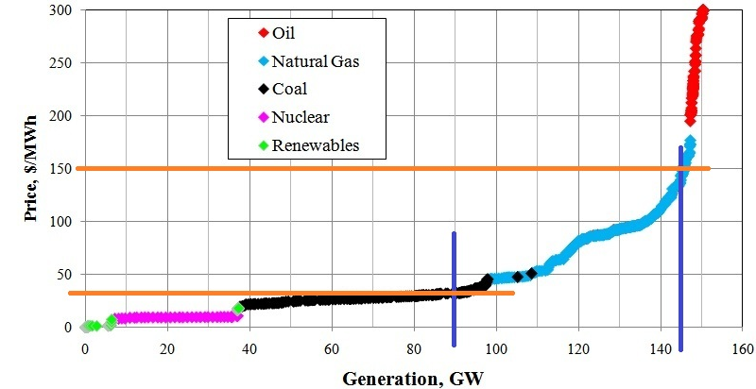
FERC v. EPSA
Electricity Market Supply Curve
(illustrative example)

Slide 12
FERC v. EPSA
Demand Response providers reduce consumption in response to a price signal.
FERC Order No. 719 (2008) requires wholesale market operators to allow aggregators of demand response resources to participate in energy markets, unless prohibited by state law.
FERC Order No. 745 (2011) requires market operators to pay demand response the same price that generators receive (LMP).

Slide 13
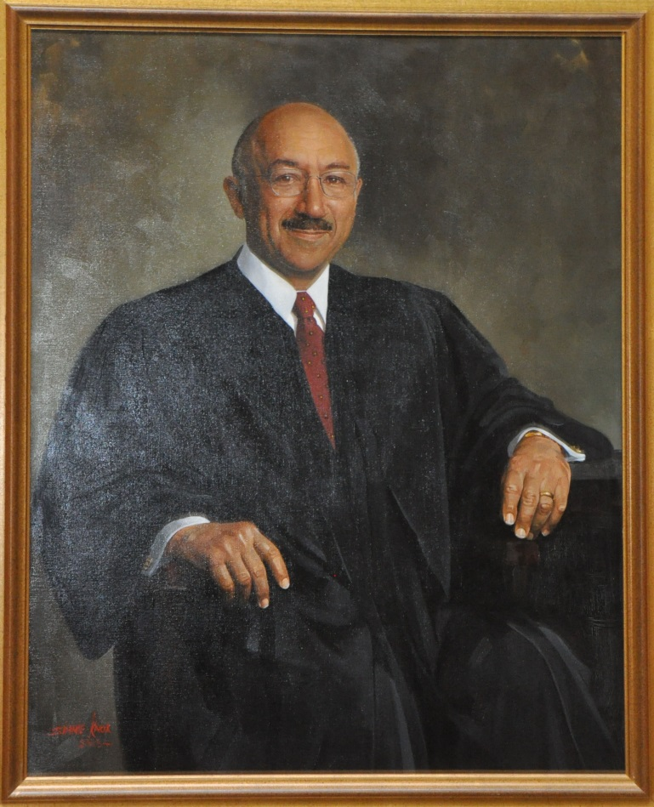
2014 DC Circuit Decision
Dissent:

Slide 14
What Did the Supreme Court Say?
FERC’s ‘affecting’ jurisdiction is limited to rules or practices that directly affect wholesale rates.
FPA does not bar FERC from regulating the wholesale market, even when doing so affects retail sales.
EPSA’s position would subvert the FPA.
FERC engaged in reasoned decision making.

Slide 15
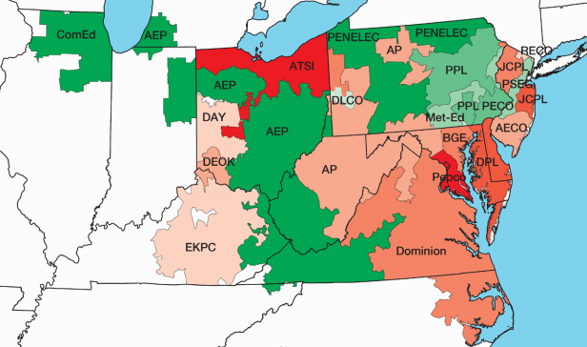
Hughes v. Talen
Net Generation
Net Consumption

Slide 16
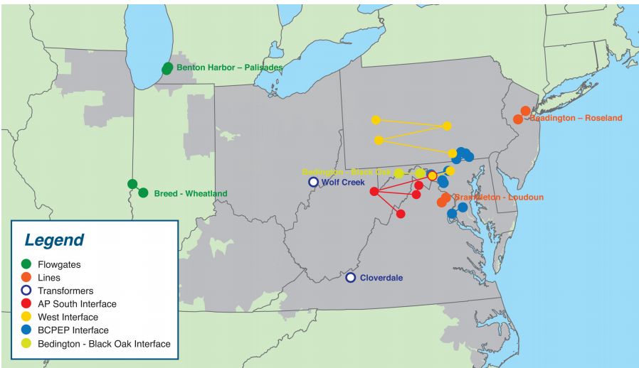
Hughes v. Talen
Top 10 Constraints Affecting PJM Congestion Costs

Slide 17
Hughes v. Talen
Maryland PSC ordered distribution utilities to enter into contracts-for-differences with a power plant developer (CPV)
Contract paid CPV the difference between set prices and the PJM energy and capacity rates.
Fourth Circuit: The PSC order “functionally sets the rate” and thus “compromises the integrity of the federal scheme and intrudes on FERC’s jurisdiction.”
NJ established a substantially similar program.

Slide 18
Hughes v. Talen
Court affirmed the 4th Circuit’s decision.
“By adjusting an interstate wholesale rate, Maryland’s program invades FERC’s regulatory turf.”
“Our holding is limited.”
“So long as a State does not condition payment of funds on capacity clearing the auction, the State’s program would not suffer from the fatal defect that renders Maryland’s program unacceptable.”
Court did not determine whether Maryland’s program was conflict preempted.

Slide 19
The State-Federal Jurisdictional Border
Has the “Bright Line” disappeared? What is the future of cooperative federalism under the FPA and NGA?
The Federal Power Act “eliminates vacuums of authority over the electricity markets.”
FPA preemption may be narrow; the scope of conflict preemption is an open question.

Slide 20
What’s Next?
Litigation Updates

Slide 21
What’s Next?
Who regulates rooftop solar?

Slide 22
StatePowerProject.org
Tracks recent lawsuits challenging State electricity policies under the dormant Commerce Clause or Supremacy Clause
Sign up for updates - http://statepowerproject.org/updates/

