Slide 1
Clean Power Plan: The Litigation, The Future, and a No Regrets Strategy
National Conference of Regulatory Attorneys
June 21, 2016| Tampa, FL

Slide 2
The Litigation

Slide 3
Why am I still doing this presentation?
Credit: the Beatles

Slide 4
The Challenges
Filed in D.C. Circuit
Three judge panel
Stay denied by the D.C. Circuit

Slide 5
Supreme Court Stay
Identical Language in Five Orders:
“The application for a stay submitted to The Chief Justice and by him referred to the Court is granted.”
What Standard Was Used?

Slide 6
Supreme Court Stay
The Clean Power Plan is stayed:
“pending disposition of the applicant’s petition for review” in the D.C. Circuit; and
“disposition of the applicant’s petition for a writ of certiorari, if such writ is sought.”

Slide 7
The Stay Votes
Credit: Steve Petteway

Slide 8
Aaarguments at the D.C. Circuit?
Not so fast, matey … the Court has other plans!

Slide 9
Litigation Timeline
Oral argument September 27
DC Circuit Court decision by spring 2017?
Timing for the Supreme Court
Timing for confirmation of a ninth Justice
Effect on CPP deadlines

Slide 10
Clean Power Plan Arguments
§7411. Standards of performance for new stationary sources
(a) Definitions. For purposes of this section:
(1) The term “standard of performance” means a standard for emissions of air pollutants which reflects the degree of emission limitation achievable through the application of the best system of emission reduction which (taking into account the cost of achieving such reduction and any nonair quality health and environmental impact and energy requirements) the Administrator determines has been adequately demonstrated.

Slide 11
Clean Power Plan Arguments
What is a Source?
Alabama Power v Costle (D.C. Cir. 1979)
Chevron v. NRDC (US 1984)
Chevron started EPA down a path of flexible approaches to Clean Air Act compliance, including the bubble option, trading, netting, and emission offsets.
EME Homer (US 2014)

Slide 12
Clean Power Plan Arguments
Can EPA Regulate Power Plants under Section 111, after Regulating them for Different Pollutants under Section 112?
Two Amendments in the 1990 CAAA
Senate Amendment: Cannot Regulate the same pollutant under both programs.
House Amendment: Cannot Regulate emissions from a source “regulated under” 112.

Slide 13
Clean Power Plan Arguments

Slide 14
Fits and Starts of other CAA Rules
March 2005 – EPA finalizes CAIR (NO_{x}, SO₂ trading program for 28 states, WDC)
July 2011 – EPA finalizes a new transport rule (CSAPR)
July 2008 – D.C. Circuit vacates the CAIR rule
Dec. 2008 – D.C. Circuit reverses itself, reinstates rule and remands to EPA

Slide 15
Fits and Starts of Other CAA Rules
Dec. 2011 – D.C. Circuit stays CSAPR
Aug. 2012 – D.C. Circuit vacates and remands CSAPR
April 2014 – Supreme Court reverses D.C. Circuit
October 2014 – D.C. Circuit lifts stay, tolls compliance deadlines by 3 years
Nov. 2015 – EPA proposes updated CSAPR
July 2015 – DC. Circuit rejects some of EPA’s state budgets and remands

Slide 16
Plan B?
Clean Air Act Section 115
Endangerment Finding
Reciprocity Determination
Formal notice to states
Acid Rain history
GHGs? Amounts?

Slide 17
Plan B?
Section 111, redux
Section 112 (list and regulate pollutants with “adverse environmental effects”)
Section 110 (GHG air quality standards)

Slide 18
Other Drivers
Notes:
Two big points here – lots of diversity and complexity already. AND, prior trading programs have worked in this dynamic environment.

Slide 19
Other Drivers
Non-EPA federal policies:
Federal tax credits extended through 2019 for wind and 2022+ for solar
40 new/updated efficiency standards since 2009
57 wind, solar, and geothermal projects approved on federal lands
PURPA contracts?

Slide 20
Other Drivers
State RPS:
 | 2015 RPS Target | 2030 Target (RPS Plateau)
Arizona | 5% | 15% (2025)
California | 20−25% | 50%
Colorado | 20% | 30% (2020)
Minnesota (Excel) | 25% (2016) | 31.5% (2020)
Nevada | 20% | 25% (2025)
Pennsylvania | 5% | 8% (2021)
Utah | - | 20% (2025) (goal)

Slide 21
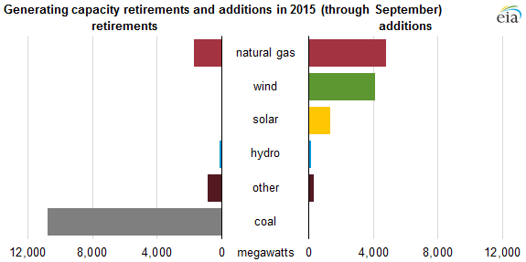
Industry Trends

Slide 22
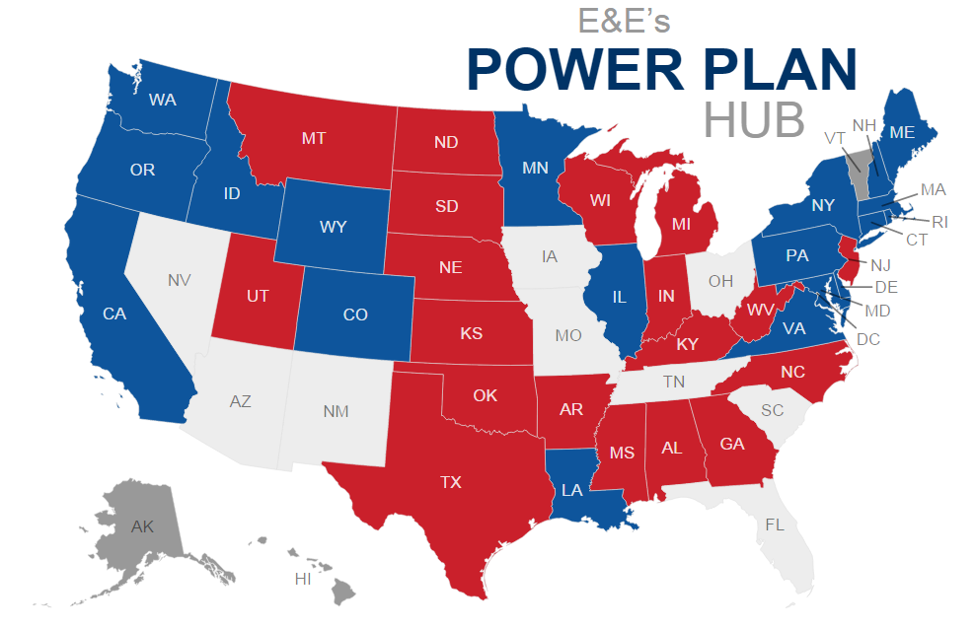
State Reactions

Slide 23
The Future/No Regrets Strategy

Slide 24
Or . . . How Not to Walk the Plank

Slide 25
Framing Questions
Are there opportunities to shape CPP compliance?
How will potential scenarios affect existing generation and transmission?
What is your state’s decision-making environment?
What are the legal/regulatory changes needed to facilitate change and “future-proof” the industry?

Slide 26
Opportunities to Shape Compliance
CEIP
Proposal out last week
Moved 9.6.16 deadline for noting interest
States could run CEIP even under a federal plan.
Expanded list of eligible projects. RE: solar, wind, geothermal, hydro. Low-income projects: EE and solar.
State program would track ERC program in model rule
States could define “low income”.

Slide 27
Potential Scenarios

Slide 28
Decision-Making Environment
Notes:
Other territories, seen as white here, are run by utilities and other balancing authorities.

Slide 29
Decision-Making Environment

Slide 30
Decision-Making Environment
Merchant generators recover costs through bilateral contracts or in wholesale markets.
Munis, coops, and federal owners (e.g., TVA) have rates set by boards or in some states, by PUCs.
Vertically integrated IOUs face cost-of-service regulation with rates set by state PUCs. Different rules, accounting methods apply.

Slide 31
Decision-Making Environment

Slide 32
State Pathways

Slide 33
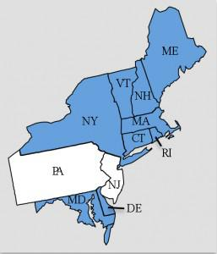
RGGI
GHG cap-and-trade program began in 10 states in 2009.
Program includes all EGUs over 25 MW (new and existing)
New cap in 2014 (91 m short tons); cap declines 2.5% annually, 2015-2020.
Notes:
Delaware Sierra Club – photo credit

Slide 34
Linkage Options
File jointly with other states; or
File alone and reference other states.
Join more than one plan or allow a subset of EGUs to engage in interstate trading.
Rate-based states with “materially consistent” plans can jointly issue ERCs.
File a mass or rate “trading-ready” plan.
Notes:
More research needed

Slide 35
“Trading Ready” Plans
Minimum Conditions:
Accept ERCs/allowances from other states;
Measure the commodity the same way (ex. short tons v. metric tons of CO₂); and
Agree to use an EPA administered or approved platform.

Slide 36
“Trading Ready” Plans
Customized design features that accommodate linkage:
Capping new Sources
Different compliance timelines
Auctions and different allocations
Banking rules
Allowance price collars (ex. RGGI, AB32)
Different ERC eligibility rules

Slide 37
RGGI and Linkage
2016 Program Review
Post-2020 cap
Changes to RGGI to comply with the CPP (offsets, CCR)
Conditions for accepting non-RGGI allowances?
Will RGGI require certain design elements of partners?
Control over other states using RGGI allowances?
WA proposed economy-wide trading program, wants access to RGGI allowances.

Slide 38
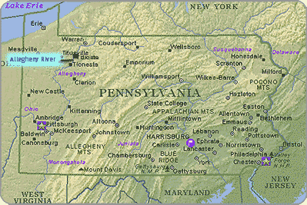
Pennsylvania and Mass Plan Design
Considering mass-based
plan
Restructured state
PJM market
4th largest coal-producing state
3d largest electricity producing state
Notes:
VA in similar situation although a much smaller energy player. Map courtesy of U of Buffalo.

Slide 39
Free Allocation
Initial assignment of allowances generally will not affect market outcomes.
Questions for free allocation:
Basis for allocation (fuel, generation, emissions)?
Update based on changed conditions (i.e., be “forward” or “backward” looking)?
Free allocations may result in a windfall for utilities in de-regulated markets
Notes:
More research needed

Slide 40
Allocations in Other Programs
Acid Rain Program features free allocations, an allowance sale and consignment auction (3% of allowances), and RE/EE set-asides.
VA auctioned NO_{x} allowances for the SIP call.
IN, OH awarded NO_{x} allowances to RE/EE.
PA, MI, MO awarded CAIR allowances to RE/EE.
Notes:
More research needed

Slide 41
Auctions
Auction: No allocation questions (market decides)
State could require “consignment” auction by third party, or allocate to non-emitters.
State can incorporate price collars, set-asides.
Auctions might be phased in.
Questions of statutory authority.
Notes:
More research needed

Slide 42
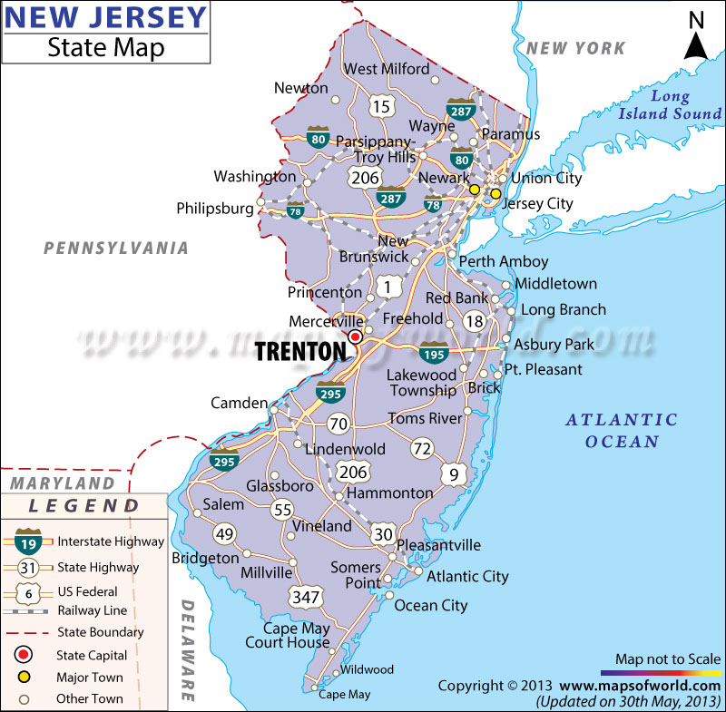
New Jersey and Rate Plan Design
Considering rate-based plan
Restructured state
PJM market
Virtually all gas-fired EGUs
Not a producer of coal, oil,
or natural gas
80% RPS met with out-of-state (PJM) projects
Notes:
Photo Credit: maps of the world.

Slide 43
Mass Benefits
Well established and familiar
Aligns with competitive electricity markets
Reduces complexity/administrative burden*
Clear environmental outcome (ton limits)
More certainty with regards to supply of compliance instruments*
May more easily expand to include other sectors.
* Advantage may be lost if using set-asides to address leakage to new NGCC.
Notes:
More research needed

Slide 44
Rate Benefits
Utilities with diverse portfolios may determine they can comply entirely “in house”.
Modeling suggests CO2 reductions could be greater under some rate-based scenarios.
States may believe they can better attract new NGCC investment under a rate-based plan.
States with strong RPS, lots of utility-scale RE, or new nuclear may be worried they are leaving dollars on the table under a mass-based program.
Notes:
More research needed

Slide 45
Eligible ERC Resources
Any Plan (Federal and State)
State Plans Only
NGCC*
New nuclear capacity*
Utility-scale hydro
On-shore utility scale wind
Utility-scale PV, concentrated solar
Geothermal
Off-shore Wind
Biomass*
CHP*
WTE*
EE*
* Means must be located in a rate-based state
Notes:
Installed after 2012. Resource must be located in a rate-based state or delivering power into a rate-based state (PPA).

Slide 46
Questions?
http://environment.law.harvard.edu/state-clean-power-plan-resources/

