Slide 1
Underground Gas Storage Facilities (USF)
Aliso Canyon Disaster
Jason Zeller: former Assistant Chief Counsel: California PUC.

Slide 2
National Profile of Natural Gas Underground Storage Facilities
The Continental United States Has 400 USF
These Facilities Are Both Owned by the Local Distribution Utility (LDC) or By a Third Party
Natural Gas Moves Through High Pressure Pipelines at 14 MPH – and Between 20-30 MPH From USFs to LDCs Systems

Slide 3
American USFs

Slide 4
Regulation of USFs
In many states USFs are not regulated by the PUCs/PSCs
Pressure and Safety Regulation is Typically Done by States
USFs Are Useful for Balancing the System and Allowing LDCs to Accommodate Changes in the Weather
Some States such as Most of New England and South Dakota Do not Rely on USFs.

Slide 5
Geology is Important
USFs Need the Appropriate Underground Geology to Operate Properly
Many USFs Are Located in Depleted Oil and Gas Fields
Drilling Techniques From the late 19th and early 20th Centuries Were Not as Advanced as Today
Many Former Oil/Gas Fields are Between 70 – 100 Years Old
As USFs Age Leaks Become More Common and Maintenance Requirements Increase

Slide 6
Inter and Intrastate Gas Pipelines & USFs

Slide 7
Types of USFs

Slide 8
Aliso Canyon Disaster
Leak Discovered October 23^{rd,} 2015 Capped February
SoCalGas Reported the Leak October 26^{th, 2015}
The Cause of the Leak is Under Investigation but it Appears to be Due to the Failure of the Casing on One of the Wells on the Site
Approximately 6,000 People Were Re-located as a Result of the Leak
Local Residents want Aliso Canyon Shut Down Permanently
SoCalGas Has Had a Request Pending with the California PUC for $200 million in Upgrades at the Field since 2014.

Slide 9
Mercaptans
Natural Gas is odorless.
Mercaptans are added to Natural Gas so that Leaks can be Readily Detected.
SoCalGas uses a Mercaptan called Scentinel (trademark) T-50 that Contains two Ingredient: tetrahydrothiophene (THT) and t-butyl mercaptans.
Traces of butane and ethane have been found in homes in Porter Ranch near the site of the leak.
Mercapatans may cause eye, nose, and throat irritation and may cause stomach discomfort, dizziness, nausea and headaches. Generally these adverse health effects will disappear once the individual is no longer exposed.
Source: Los Angeles County Dept. of Health

Slide 10
Aliso Canyon Well Site

Slide 11
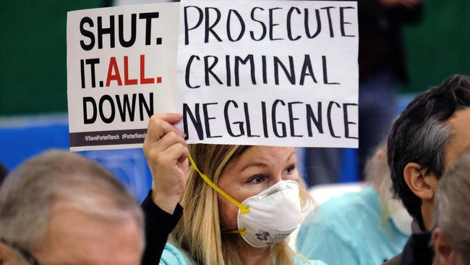
Public Meeting During The Leak

Slide 12
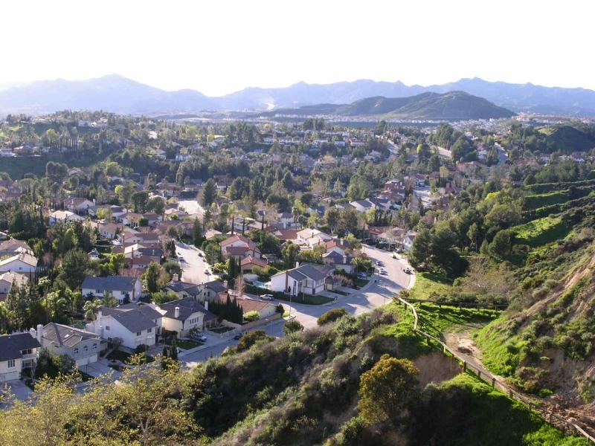
Photos of Porter Ranch Neighborhood

Slide 13
Aliso Canyon Gas Leak Timeline
Initial Discovery of Gas Leak: 10/23/15
City of Los Angeles Files Claim Against SoCalGas 12/7/15
Governor Brown Declares State of Emergency: 1/6/16
The South Coast Air Quality Management District Brings Claim Against SoCalGas alleging negligence in design, construction, operation and inspection of the USF—possible penalties $251,000 per day
Relief well is completed and leak stops: 2/16/16

Slide 14
Regulatory Response
California Department of Conservation, Division of Oil, Gas and Geothermal Resources (DOGGR) pursuant to the Governor’s Executive Order has initiated a new testing regime for all 114 active wells in the Aliso Canyon Field that must be passed before the field can resume operations including daily testing, use of leak detection technologies and numerous other requirements.

Slide 15
California Public Utilities Commission
Relevant Statutes: Cal. Pub. Util. Code 451: “…Every public utility shall furnish and maintain such adequate, efficient, just and reasonable service equipment and facilities…as are necessary to promote the safety, health, comfort, and convenience of its patrons, employees and the public.”
Section 315 “The Commission shall investigate the cause of all accidents …resulting in the loss of life or injury to person or property and requiring in the judgment of the Commission, investigation of it…

Slide 16
Other Pub. Util. Code Provisions
Section 2107: “Any public utility that violates or fails to comply with an part or provision…of any order, decision, decree, rule, regulation, direction, demand or requirement of the commission is subject to a penalty…of not less than $500, nor more than $50,000 for each offense.
[Note penalties are levied on a per day basis, i.e., up to $50,000 per day per violation].

Slide 17
Volume of Gas Leak
Estimated 97,000 tons of gas was released during the leak. Equivalent to 8,148,000 tons of CO2
This is the largest leak from a single source in U.S. history.
The gas released was primarily methane which is 84 times as potent a greenhouse gas as carbon dioxide.
Governor Brown has said SoCalGas will be required to mitigate the effects of the leak.

Slide 18
Litigation Exposure
Los Angeles County’s District Attorney has filed a misdemeanor criminal complaint against SoCalGas.
Several Class Action Claims Have Been Filed Against SoCalGas-- estimated possible liability is over $1 billion. Among the claims are requests for business interruption (lost profits).
One wrongful death claim has been brought.
Attorney General Kamala Harris has filed a claim on behalf of the state.
The California Commission has not opened an investigation into the Aliso Canyon leak yet but it has required SoCalGas to separately track Aliso related costs. Information about the Commission’s activities can be found at www.cpuc.ca.gov/Aliso.

Slide 19
The Pipes Act of 2016
Passed Congress June 14, 2016
Expands Authority of the Pipeline and Hazardous Materials Safety Administration (PMSA)
PMSA is Granted Authority to Issue Minimum Safety Standards for USFs
Creates a Task Force to Investigate Aliso Canyon Blowout
HR 4937
Gives PMSA to Issue Emergency Orders After Accidents

