Slide 1


PLANNING FOR LOWER-COST, LOWER-RISK ENERGY
Notes:
1
1

Slide 2
The Commission should obtain missing risk and cost information before determining suitability
Ten-year site plans must provide sufficient information to assure the Commission that an adequate and reliable supply of electricity at the lowest cost possible is planned. Form PSC/RAD 43-E (11/97)
Plans currently fail to analyze future portfolio scenarios, missing lower-cost, lower-risk alternatives to new gas-fired capacity.
The Commission should obtain the missing comparative analysis of all sources and technologies, and then propose alternatives to the current plans as needed to reduce overall cost and risk in state’s portfolio.

Slide 3
Plans must account for risk and cost
Cost should reflect life of investment, including risks that could materially affect investment and benefit to customers.
Risk is the expected value of a potential loss. It is measurable, based on probability of harm from an adverse event.
The Commission needs cost and risk information to fulfill its duty to consider, among other things, the plans’ consistency with the State Comprehensive Plan, which states relevant Florida policy as follows:
“Develop and maintain energy preparedness plans that will be both practical and effective under circumstances of disrupted energy supplies or unexpected price surges.” Fla Stat. § 187.201 (11)(b)(10)

Slide 4
Florida’s energy system at a crossroads,
facing high-risk and low-risk paths forward
High dependence on natural gas (FRCC 2013)
Significant near-term coal and nuclear retirements, potentially exacerbating natural gas dependence
Limited infrastructure diversity (FRCC 2013)
Rapidly improving cost-competitiveness of renewable sources and energy efficiency
Fossil fuel and nuclear generation economics strained by weakened industry credit ratings and increasingly stringent pollution controls

Slide 5
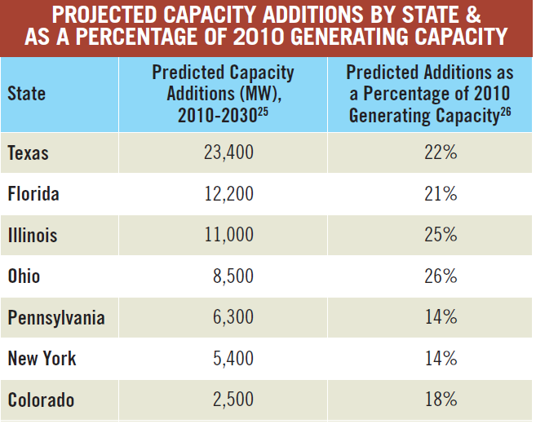
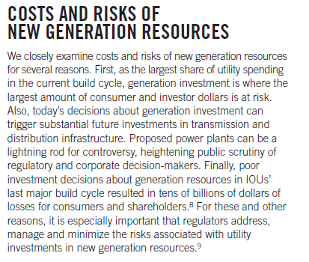
Florida’s generating capacity investments expected to be among Nation’s highest
Source: Ron Binz & CERES, Practicing Risk‐Aware Electricity Regulation: What Every State Regulator Needs to Know (2012) (“Risk-Aware”), at 16.

Slide 6
Natural gas unduly dominates current and planned generation portfolio
Now ~63% of Florida’s delivered electricity is natural gas-powered (FRCC 2013)
FRCC still studying “potential multiple generation retirements from the same site, starting as early as April 2015” (FRCC 2013)
Non-gas retirement/retrofit decisions threaten to exacerbate Florida’s fuel diversity problem

Slide 7
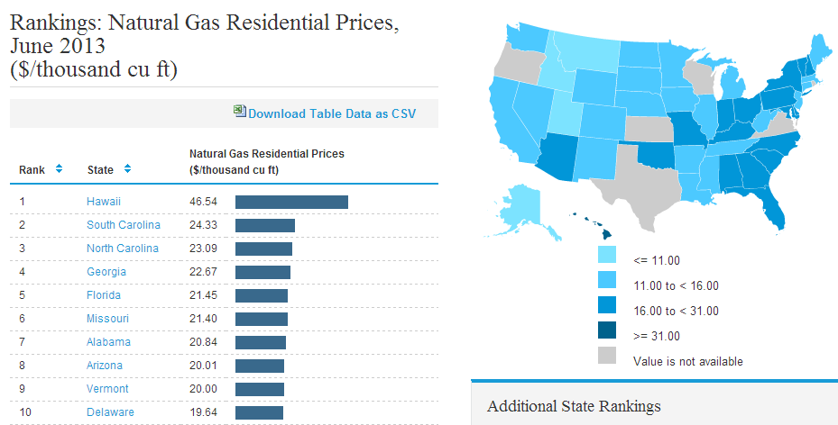
Florida ratepayers already paying some of Nation’s highest gas prices
Source: EIA (2013), http://www.eia.gov/state/rankings/?sid=US#/series/28

Slide 8
Florida’s high gas dependence is risky
Supply: Sharp downward revision in 2012 EIA estimates of U.S. shale gas reserves by > 40%, Marcellus reserves down by 66%
Demand: EIA predicts rapid LNG exports paired with lower resource base could raise natural gas prices by 54% by 2018
Price: 2013 US DOE-commissioned study finds higher natural gas prices in 2015 expected to have negative effects on output and employment , particularly in natural gas-intensive sectors
Infrastructure: Florida at risk because it imports nearly all of its fuel, has no native gas reserves or supplies, and relies on two inter-state pipelines

Slide 9
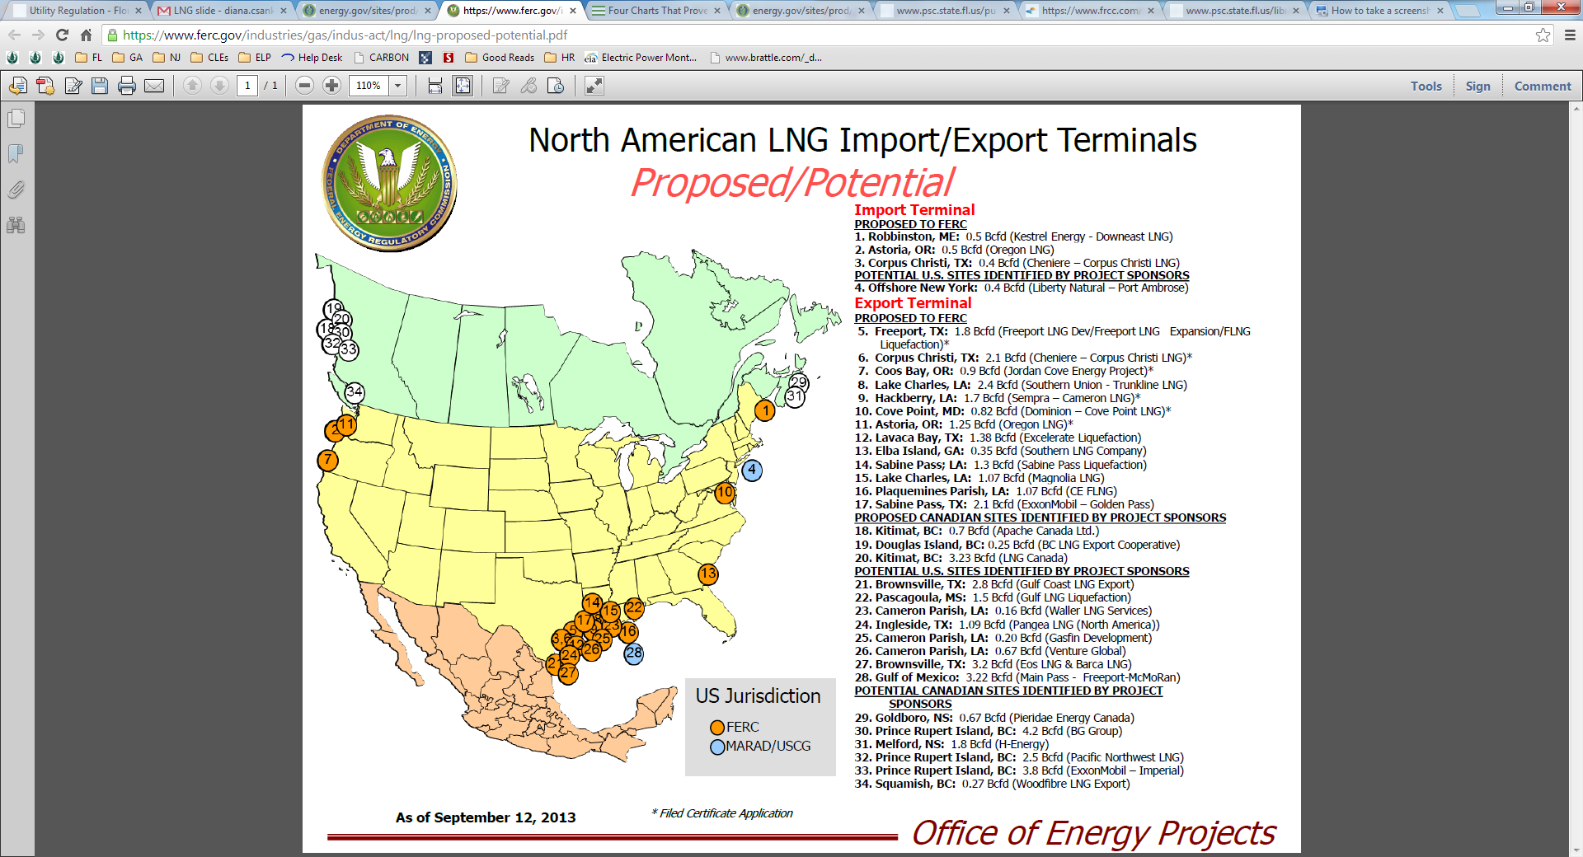
Industry rapidly moving forward with gas exports

Slide 10
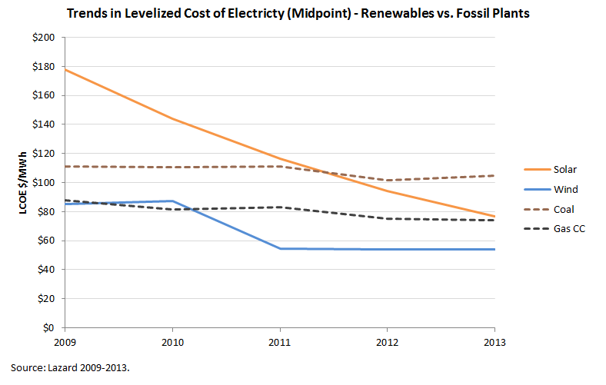
Renewable sources like solar increasingly cost-competitive

Slide 11
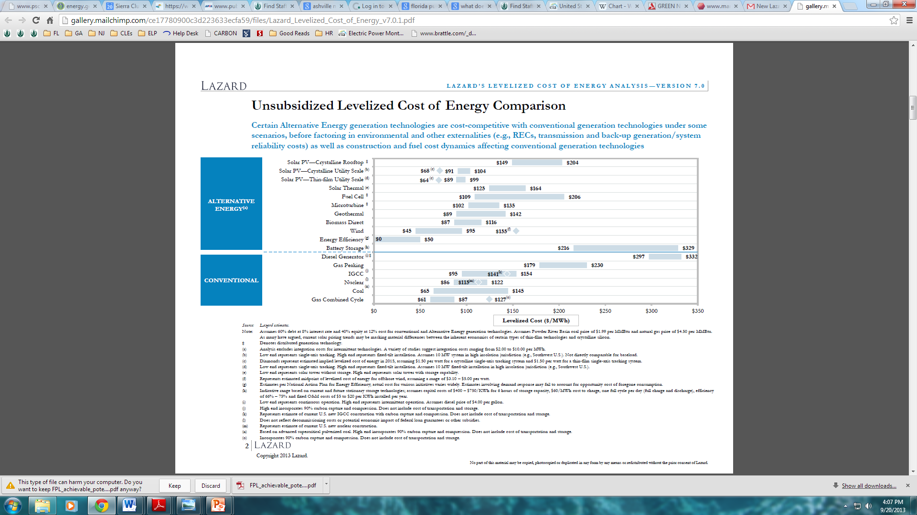
Energy efficiency is lowest-cost, lowest-risk option
RELATIVE RISK RANKING OF NEW GENERATION RESOURCES
HIGHEST COMPOSITE RISK
Nuclear
Pulverized Coal
RELATIVE COST RANKING OF NEW GENERATION RESOURCES
Coal IGCC-CCS
Nuclear w/ incentives
Coal IGCC
Coal IGCC-CCS w/ incentives
Natural Gas CC-CCS
Biomass
Coal IGCC w/ incentives
Natural Gas CC
Biomass w/ incentives
Geothermal
Biomass Co-firing
Geothermal w/ incentives
Solar Thermal
Solar Thermal w/ incentives
Large Solar PV
Large Solar w/ incentives
Onshore Wind
Solar—Distributed
Onshore Wind w/ incentives
Efficiency
Cost ranking based on Lazard unsubsidized levelized energy cost comparison (2013), at 2.
Risk ranking based on Ron Binz & CERES, Practicing Risk‐Aware Electricity Regulation: What Every State Regulator Needs to Know (2012), at 8.
LOWEST COMPOSITE RISK

Slide 12
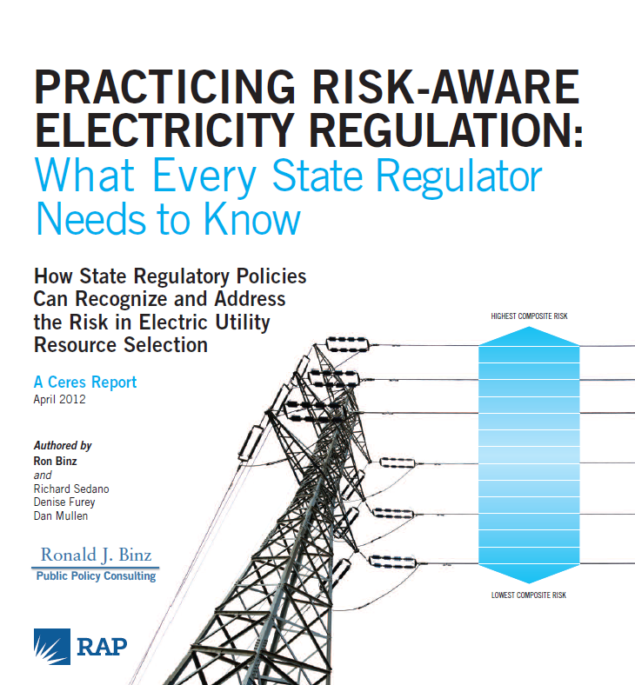
Florida has clear roadmap for risk-aware planning, centering on diversification
Per report’s detailed cost and risk analysis of wide range of generation sources, safe investment strategies include:
Diversifying energy resource portfolio
More emphasis on energy efficiency because it is lowest-cost, lowest-risk resource
More emphasis on renewables because they are low-cost, low risk

Slide 13
Low-cost, low-risk generation options exist,
need to be rigorously explored
E.g., Georgia: Georgia Power Company’s 2013 RFP for Solar Photovoltaic Generation and Utility Scale Power Purchase Agreement for 210 megawatts (MW) of solar capacity in 2013 and ’14.
  RFP “add[s] an enormous amount of renewable energy to our mix for years to come without increasing rates.”
  - GA Commissioner Echols (May 2013)
  E.g., Colorado: In September 2013, Xcel Energy proposed adding 170 MW of utility scale in-state solar power and 450 MW of in-state wind power
"We are not taking on solar because we have to, but because it is cost-effective and economical.”
- M. Aguayo, Xcel Energy (Sept. 2013)

Slide 14
Recommended next steps for the Commission
Defer suitability determination until the Commission receives requisite supplemental data and analysis from each utility subject to ten-year site planning.
Issue state-wide request for EE/RE/DSM project proposals, or order utilities to issue such requests, publishing results.
In suitability determination, specify actions Florida will take to reduce overall cost and risk in the state’s energy portfolio.

